Slide 1
Chicago Crime Statistics Results and Recommendations
Analysis of Crime Statistics from
Chicago’s Data Portal in 2018
Gil Graybill – UNCW Business Analytics Masters Program
BAN 502- March 6, 2020

Slide 2
Data Transformation
Original Data
While all these variables are important, for this project all of them are not needed.
Arrest
Date
Block
IUCR
Primary Type
Description
Location Desc.
Domestic
Beat
District
Ward
Comm. Area
FBI Code
Longitude
Latitude
Location
Case #
Block, Beat, District, Ward, and Community Area are all geographical areas.
IUCR, Primary Type, and FBI Code are all different ways to categorize the type of crime.
Description and Location Description have text in them that can be parsed out.
We need to limit it down to those variables that might be worthy of consideration and don’t duplicate data.

Slide 3
Data Transformation
Original Data
Analyzed Data
Arrest
Date
Block
IUCR
Primary Type
Description
Location Desc.
Domestic
Beat
District
Ward
Comm. Area
FBI Code
Longitude
Latitude
Location
Case #
Arrest
* Hour (Date)
* Month (Date)
District
Domestic
FBI Code
* In_street (Location Desc)
* In_business (Location Desc)
* In_residence (Location Desc)
* New Derived Variables

Slide 4
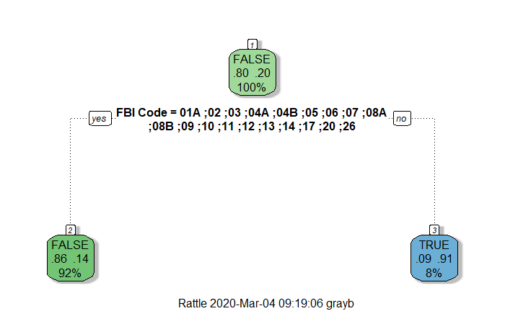
A Decision Tree is modeling technique based on simple “if-else” logic. Most Decision Trees are bigger than this.
A Simple Model: Decision Tree
Step 1: Is the crime one of the listed FBI Codes?
Step 2A: If it is (YES), go to the left. There is a 14% chance of arrest
Step 2B: If it is not (NO), go to the right. There is a 91% chance of arrest.
This predictive model has an accuracy rate of 86.8%.

Slide 5

Other types of predictive models were created. All had accuracy rates between 86% and 87%. There were visible diminishing returns as more variables were added. “FBI Code” seems to be an overwhelming predictor for Arrest Rates.
Predictive Models Summary
Model Types and Accuracy
From analyzing the dataset, the arrest rate is 20%. Having a “Null Model” where no arrests are predicted would be 80% accurate, but also pretty worthless.
Logical Threshold: 86.9%
Random Forest: 86.3%
Ensemble: 87%
Stacking: 87%

Slide 6
The value of the variables
For one model, “District” and “In_Residence” had value.
In another, “In_Residence” and “Domestic” were helpful.
In a different one, “In_Business” had some predictive value.
By far, “FBI Code” seems to be the best predictor of Arrest rates.
Adding 1% accuracy to a model might not seem like much, but since the data is readily available and adds value, it is wise to utilize it.
Q: What does it mean when all the models come up with a similar result?
A: It means we have good, predictive data and our modeling techniques are valid

Slide 7
Conclusion
As future crime rates change, so will the arrest rate, and that has a direct impact on Chicago’s resources. An individual arrest is a key milestone for a crime. It starts off a series of investigations by workers in the justice system that could lead to a trial, conviction, and jail time.
Using statistical modeling, we can analyze the crimes committed and determine what the number of arrests will be, where they will occur, and for what crimes they will happen. Knowing this will allow the city to shift resources or anticipate if resources are lacking. The modern approach will help Chicago remain at the cutting edge of technology, which, more importantly, best utilize what is available and ultimately be a benefit for the citizens of this great city.

